Slide 1
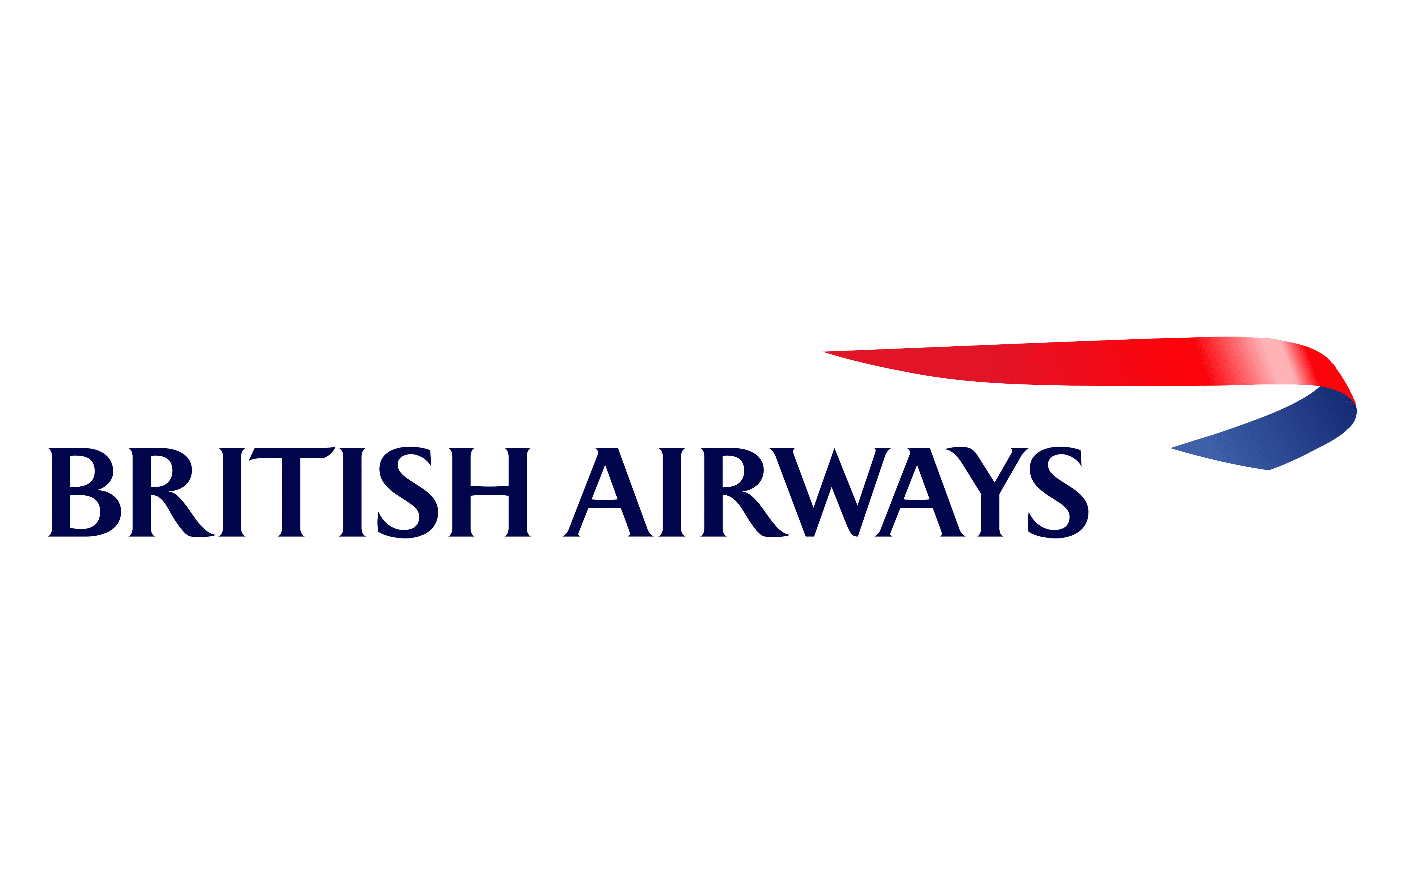
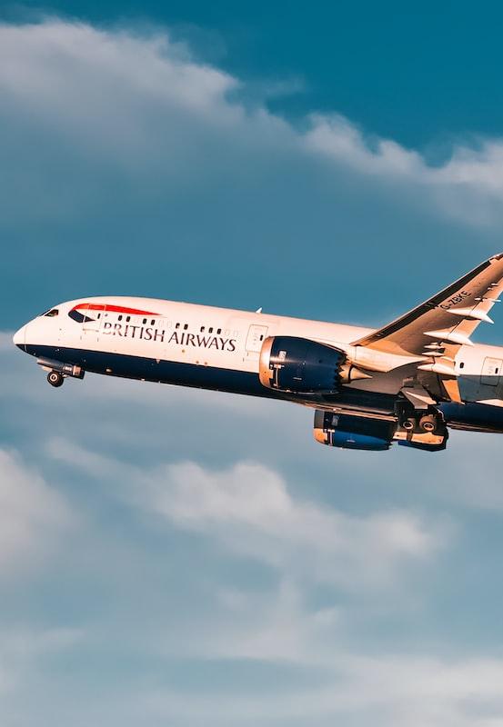


Exploring Customer Experience with British Airways
British Airways Data Science Job Simulation on Forage
by Tito Dwi Syahputra

Slide 2
Table of Contents
1
2
3
4
Introduction
Brief introduction about this project
Data Preparation
How we can get the data?
Uncover Insights
Exploratory Data Analysis
Topic Modeling
5
What topics are mainly discussed?
Recommendations
Recommendation for British Airways

Slide 3

1
Introduction
Brief introduction about this project

Slide 4




Introduction
BACKGROUND
Customers who book flights with British Airways will experience many interaction points with the brand.
Understanding a customer’s feelings, needs, and feedbacks is crucial for the business, such as maintaining consistently quality standards, and enhancing product and service quality to meet the customer needs and expectations.
This can be approached by exploring British Airways customer reviews and conducting Topic Modeling with Machine Learning on the reviews.
OBJECTIVE
Collecting customer feedback and reviewing data from a third-party source.
Analyzing the data to present any insights we may uncover.
Conducting Topic Modeling to know what topics are mainly discussed on reviews
201
METHODOLOGY
Web scrapping
Exploratory Data Analysis
Topic Modelling with LDA
BUSINESS QUESTION
What is the overall rating given by customers when they either recommend or don't recommend this airline?
How does the customers overall rating and satisfaction level given their type of seat?
How does the customers overall rating and satisfaction level given their type of traveller?
What are the common key words that are used by the customers on the review?

Slide 5

2
Data Preparation
How we can get the data?

Slide 6
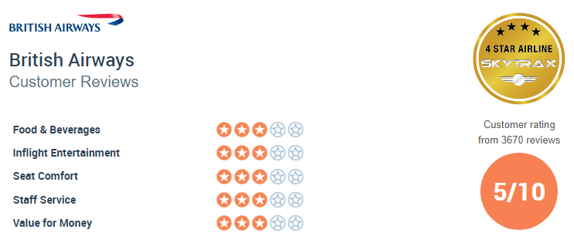
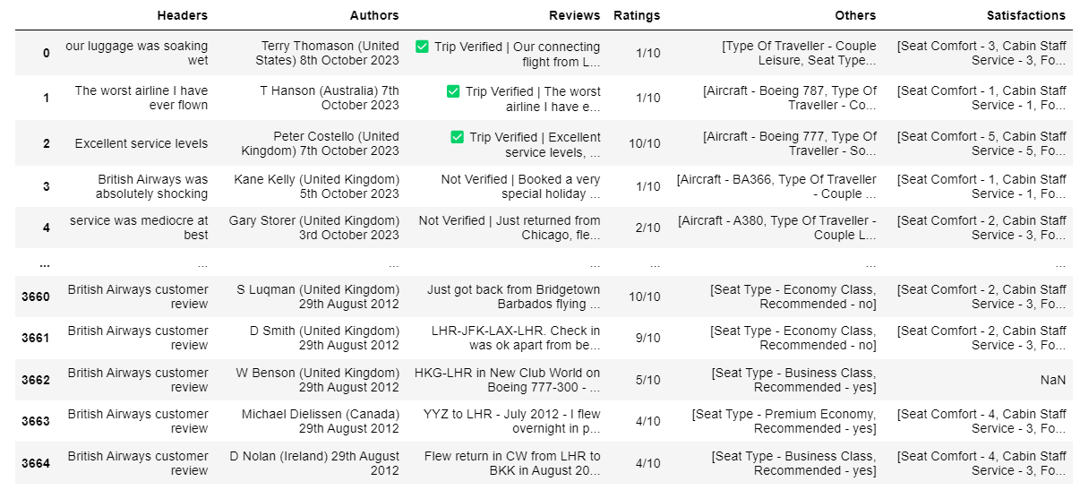
Data Preparation Process
Web Scraping
Data Wrangling
Turning the data into more convenient format
Good format dataset
Handling Special NaN
Python
Beautifulsoup
Check Duplicates
Drop features (>80% NaN and irrelevant features)
https://www.airlinequality.com/airline-reviews/british-airways/
Drop NaN due to web scrapping process
Impute NaN
(Mode and MICE imputer)
Check Data Types
Extract Features

Slide 7
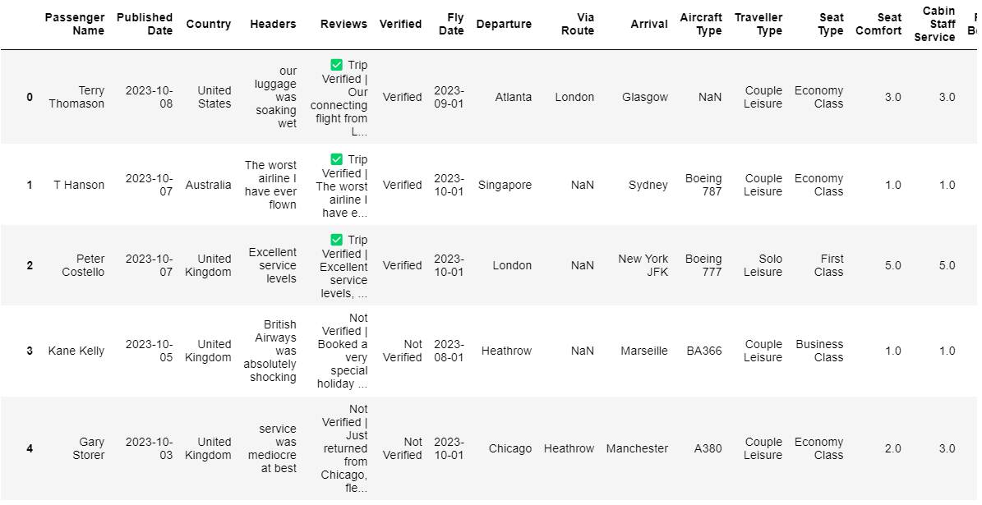
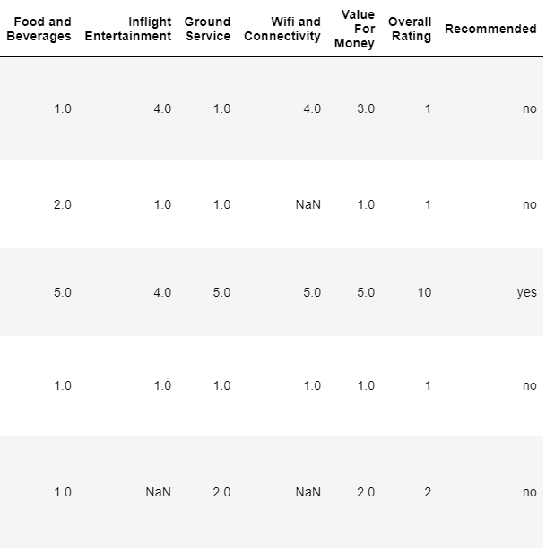
Good format Dataset after Data Wrangling process
Web Scraping Data
Extracted Features from Web Scraping Data
Notice there are some NaN values due to the nature of data where customers didn’t give their review on other particular categories

Slide 8
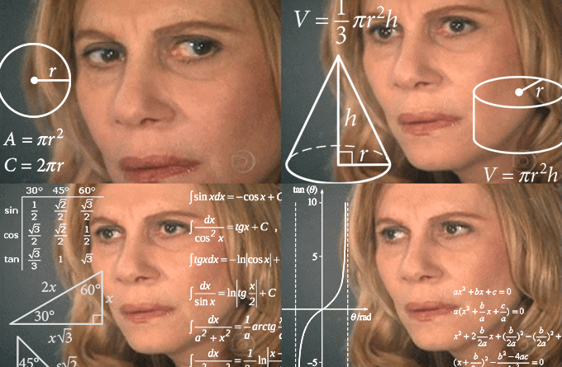
3
Uncover Insights
Exploratory Data Analysis

Slide 9
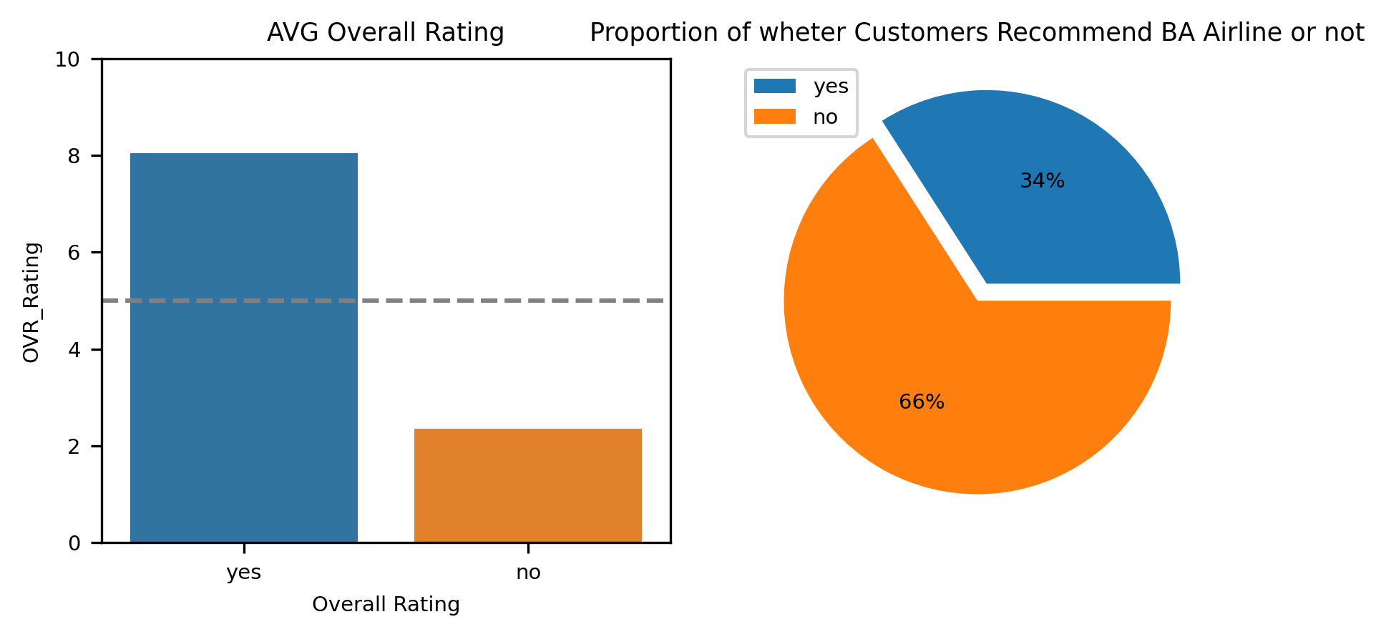
EDA (1)
What is the overall rating given by customers when they either recommend or don't recommend this airline?
Out of 2449 customers,
34% of customers recommended British Airways Airline with 8 out of 10 stars Overall Rating.
66% of customers didn't recommend it with 2.35 out of 10 stars Overall Rating.

Slide 10
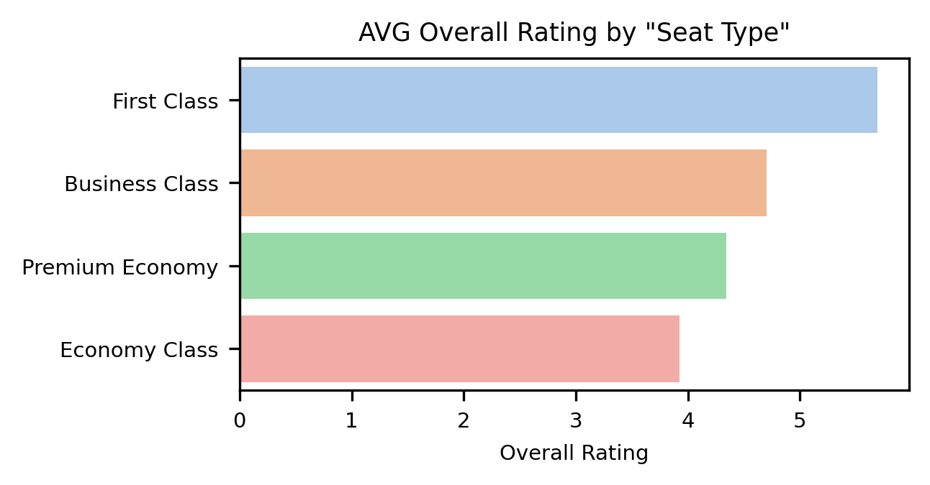
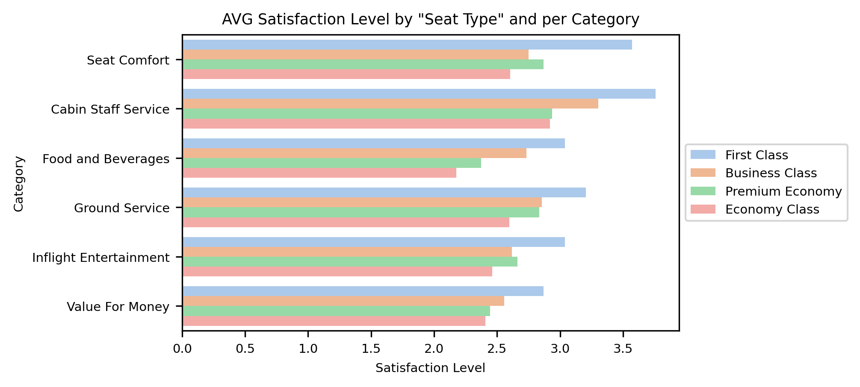
EDA (2)
How does the customers overall rating and satisfaction level given their type of seat?
The highest AVG Rating
As we might expect that "First Class" will be giving us the highest Overall Rating then followed by "Business Class", and the lowest is "Economy Class".
Also the pattern is the same for the Satisfaction Level per category where "First Class" is the highest and "Economy Class" is the lowest.
This is very reasonable since "First Class" would be providing us far better facilities, services, seats, foods, or beverages most of the time.
The lowest AVG Rating

Slide 11
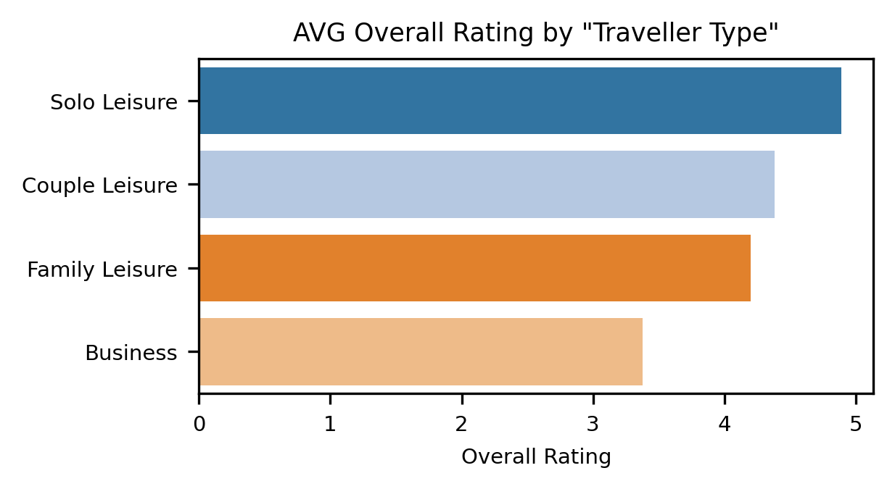
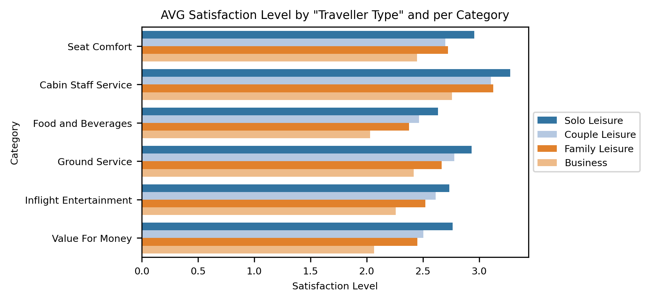
EDA (3.1)
How does the customers overall rating and satisfaction level given their type of traveller?
The highest AVG Rating
Turns out "Solo" traveller gives us the highest Overall Rating than "Business" traveller, meaning that they enjoy the airline experience the most (The highest Satisfaction Level) compared to "Business" traveller.
My hypothesis is that probably most of “Solo” travellers tend to book high quality Seat Type, such as "First Class" and "Business Class“.
Let’s check our hypothesis furthermore why “Solo” and “Business” travellers give us different ratings??!!
The lowest AVG Rating

Slide 12
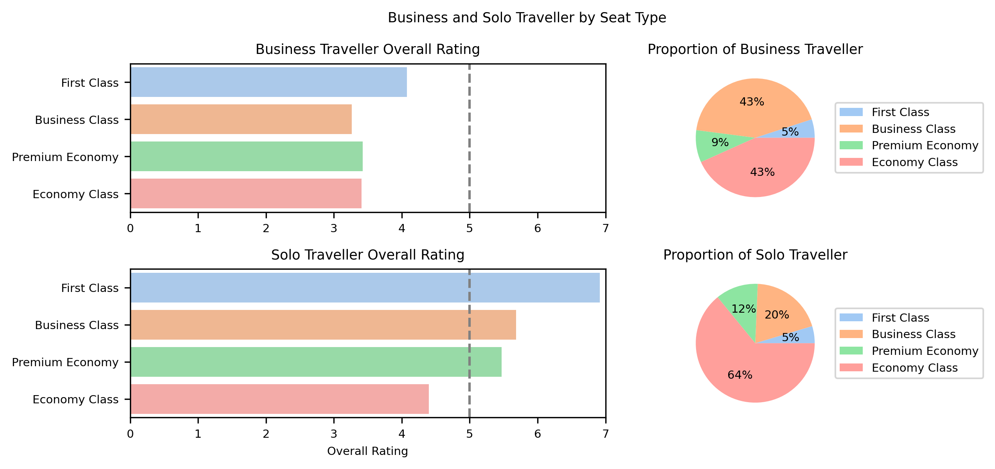
EDA (3.2)
How does the customers overall rating and satisfaction level given their type of traveller?
All Seat Types’ AVG Rating are below 5 stars!
As we know that "First Class" and "Business Class" cabin would provide customers the best facilities and services, but unfortunately "Business" traveller doesn't seem to have a good experience on it so much.
Their Satisfaction Level and Overall Rating to the services and facilities within "First Class" and "Business Class" are relatively low.
I have another hypothesis that there is also another particular issue leading them to give low Overall Rating within "First Class" and "Business Class" . Now let’s check the review data (in Topic Modeling)!
Most of Business Traveller!
Most of Solo Traveller!
Apparently my previous hypothesis is wrong!
"Business" traveller often books for "Business Class" cabin (43%) while "Solo" traveller books more often in "Economy Class" cabin (64%).
"Business" traveller tends to give us Overall Rating below 5 stars most of the time regardless of whether it is "First Class" or "Business Class", meanwhile "Solo" traveller tends to give us above 5 stars Overall Rating for the "First Class", "Business Class" and even "Premium Economy".

Slide 13
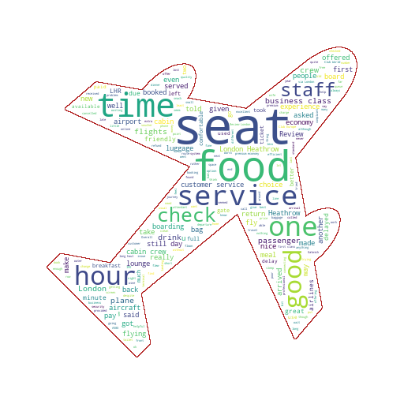
EDA (4)
What are the common key words that are used by the customers on the review?
We can suggest that the common key words used within the reviews are "Seat", "Food", "Service", "Time", and "Staff" showing that customers are actively talking about their experience about on those categories.
The "Good" word also highlighted on the Word Cloud, this have to be the positive sentiment.
Also the word "Hour" might be indicating waiting time for delayed flight.

Slide 14
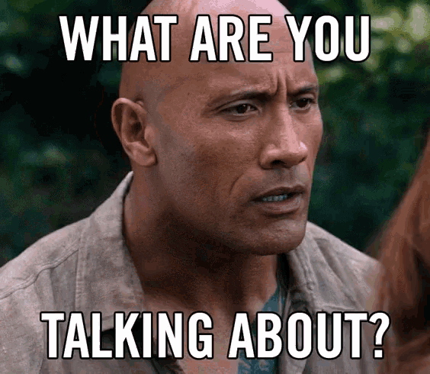
4
Topic Modeling
What topics are mainly discussed?

Slide 15

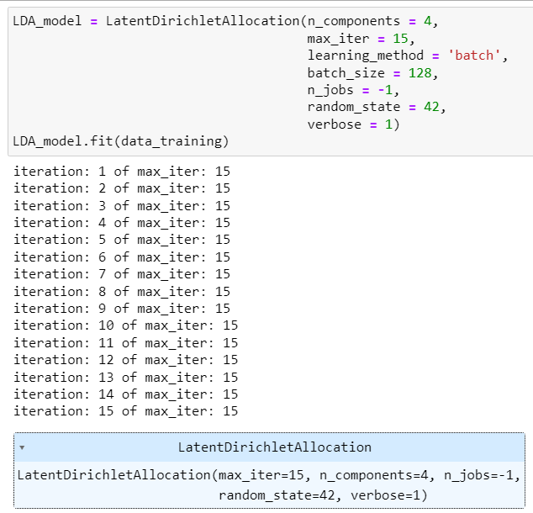
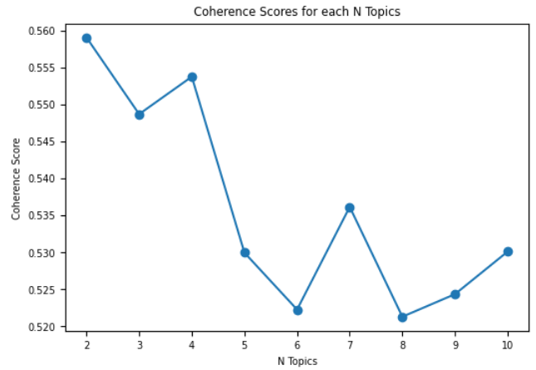
Topic Modeling Process
Text Preprocessing
Convert raw text into cleaned format
Bag of Words
Convert a collection of text documents to a matrix of word counts
Find the best n Topics
Given LDA model, Find the optimal number of topics
Build LDA model
Choose
the best number of topics N = 4
Interpret LDA model
Infer each topic according to their corresponding key words
Raw Text
2449 Total Documents
Lower case and remove verification status
1-gram and
2-grams
Coherence scores
Tokenization
Remove stopwords, punctuations, and whitespaces
Optimal Number of Topics!
Lemmatization

Slide 16
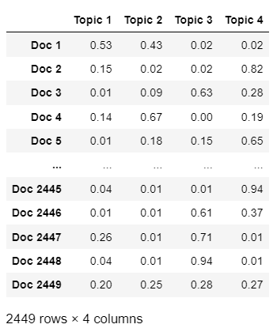
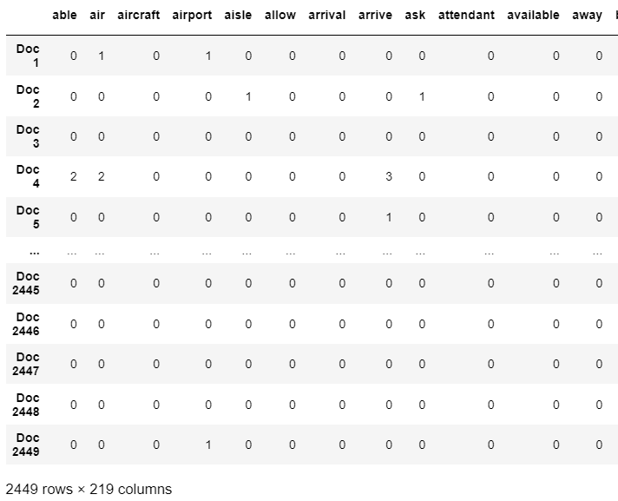
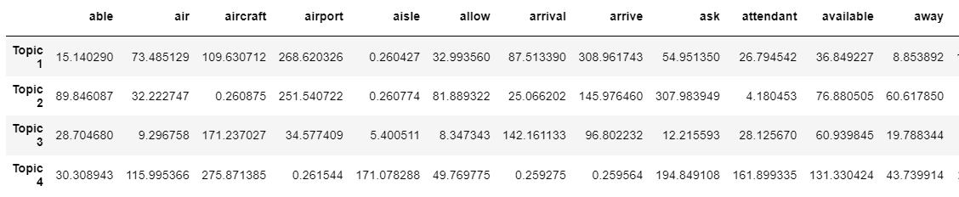
LDA Model Result
LDA Model with n_components = 4
Matrix output 1 with n_doc x n_components dimensions
Matrix Input with n_doc x n_features dimensions
Matrix output 2 with n_components x n_features dimensions

Slide 17
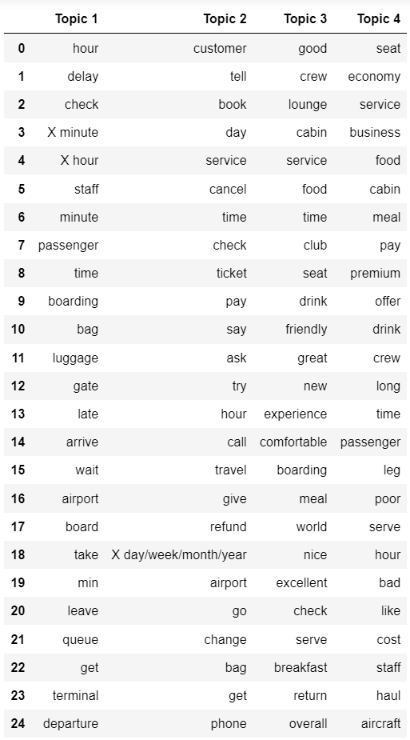
LDA Model Interpretation
Top 25 keywords of each topic from “Matrix output 2”
From the LDA model key words, we can infer that,
Topic 1 mainly discusses about customers' Time Issue, such as:
customers got delayed airplane.
customers had to spend much more time waiting for either luggage/bag, check-in, or boarding, in which those things can spend "X minute" or "X hour" of waiting time more than they were expected.
Topic 2 mainly discusses about British Airways' Customer Service/Flight Issue, such as:
customers was forced to rebook flight or got cancelled flight in "X day/week/month/year" before departure due to some reasons.
customers had to wait for refund/reimbursement in so much long time (can be in X day/week/month).
Although they had already called, asked and tried to reach the customer service, there is still no a certainty/response from them.
Topic 3 mainly discusses about customers' Good-Inflight Experience with British Airways, such as:
friendly and nice flight crew.
good at food/drink/meal/breakfast/time.
having excellent service and great experience.
comfortable seat.
Topic 4 mainly discusses about customers' Bad-Inflight Experience with British Airways, mostly in "Economy", "Premium Economy", and "Business" classes which mostly happened during long-haul flight, such as
problem with customers' leg due to airplane seat.
poor service from staff/flight crew.
lack of offering or long-time serving food/drink/meal.
bad taste in food/drink/meal.
overall cost/pay for the flight was not as they were expected.

Slide 18
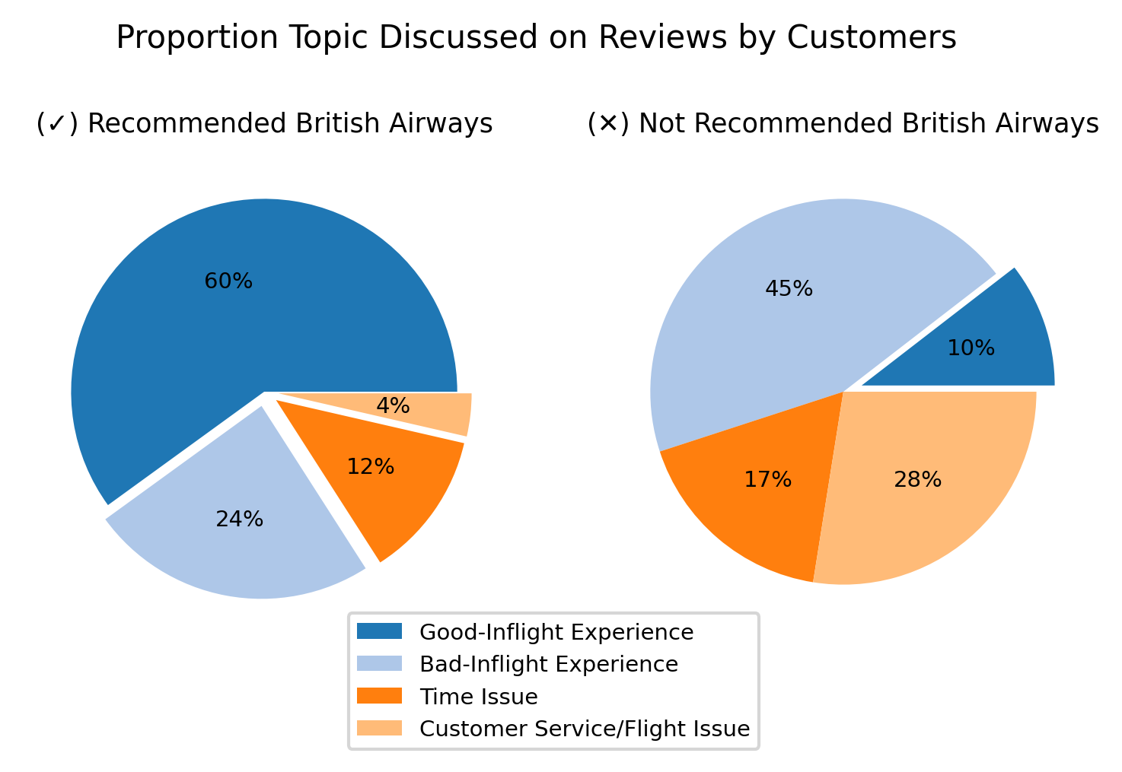
Analyze the Topics
Proportion Topic Discussed on Reviews by Customers of whether They Recommended BA or not
10% positive sentiment
40% negative sentiment
Our LDA model seems to have a quite decent performance of differentiating both positive and negative sentiment reviews.
For customers recommending BA airline (Left Pie-Chart), 60% of them mainly talked about positive sentiment topic, Good-Inflight Experience.
For customers NOT recommending BA airline (Right Pie-Chart), 90% of them mainly talked about negative sentiment topic, Bad-Inflight Experience, Customer Service/Flight Issue, and Time Issue.

Slide 19
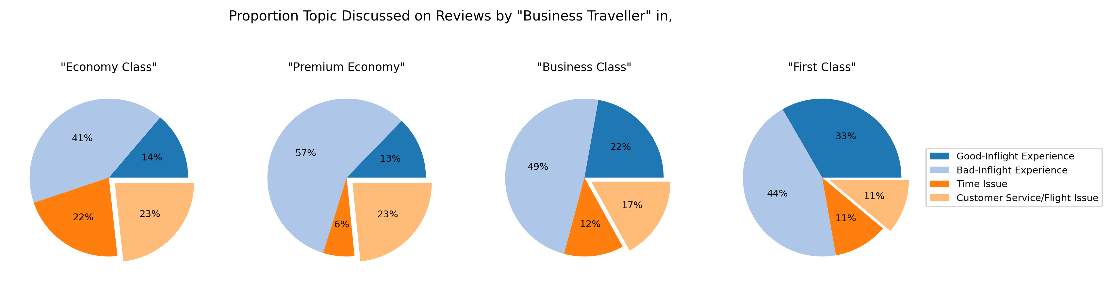
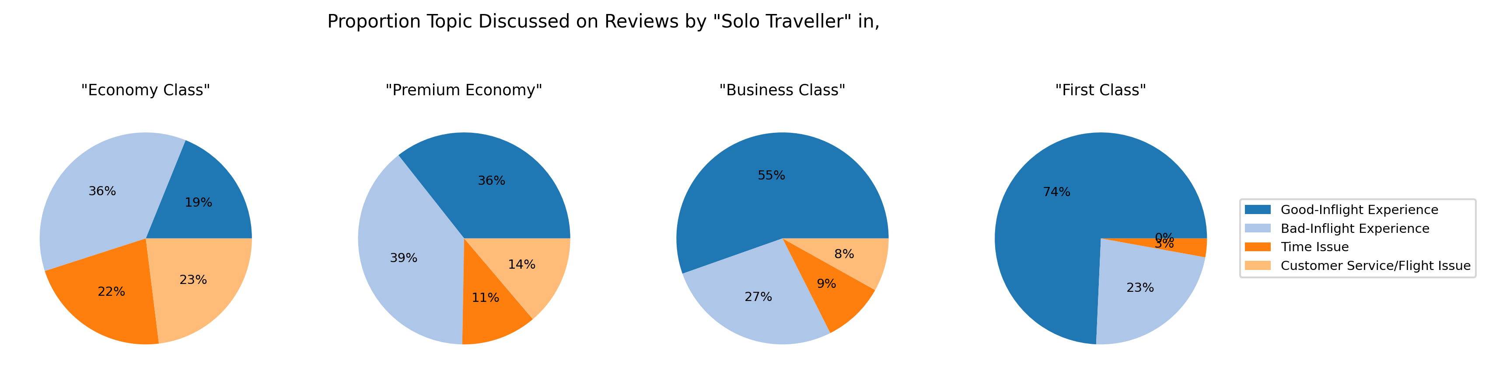
Analyze the Topics
Proportion Topic Discussed on Reviews by Business and Solo Travellers in different type of seat
Business Traveller:
Majority Seat Types choosen by "Business" travellers are “Economy” and “Business” classes (see EDA (3.2)), but regardless of the seat type that they chose whether it was "Economy" or “Business”, They seemed to be having Bad-Inflight Experience then followed by Customer Service/Flight Issue.
The second most negative sentiment topic discussed by “Business” travellers are Customer Service/Flight Issue. This might be the other reasons of why they gave below 5 stars Overall Rating on average most of the time.
Most of "Business" travellers are more likely not to tolerate cancelled/rebooked flight as they usually have already had on-time schedule for “Business Purpose”.
Solo Traveller:
Comparead to “Solo” travellers, they seem to be most likely having Good-Inflight Experience in "First" and "Business" classes.
The 2nd most negative sentiment topic discussed by “Business” travellers
Having Good-Inflight Experience most of the time in “high class” seat type

Slide 20

5
Recommendations
Recommendation for British Airways

Slide 21
Recommendations
Delayed/Cancelled Airline
Be transparent about the reasons of delayed and cancelled flights.
Offer compensation (in the form of snacks/vouchers/cashes) if the delayed/cancelled airplane is due to factors within their control, such as maintenance issues all of sudden.
If the delay results in an overnight stay, the airline should provide vouchers for food and accommodation to stay overnight.
If the customer is in a hurry to get the destination on-time (especially “Business” traveller), the airline should provide alternative transportation such as a train or rental-car if it’s possible, to ensure the customer reaches their destination on-time.
Other Categories
Keep assisting and getting in touch with customers in seeking for compensation/reimbursement/refund from the airline.
Handle the compensation/reimbursement/refund as soon as possible.
Re-design the seat on airplane so that can provide comfort, especially for those who have long leg problem .
Ensure that airline staff are well-trained, motivated, and satisfied with their jobs. Happy employees are more likely to provide excellent customer service.
Offer high-quality food and beverage, and give more options on food and beverage.
Minimize mishandled baggage incidents.

Slide 22




Thanks!
Feel free to connect with me!

